Slide 1
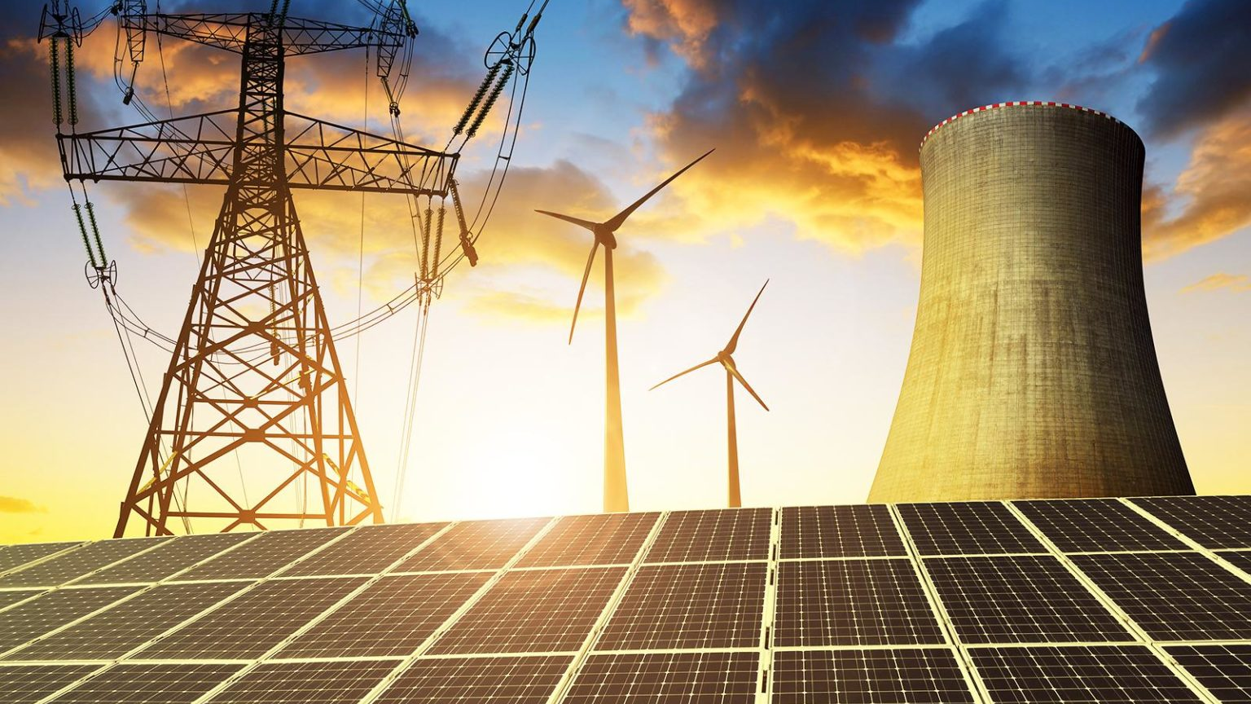

Analysis of Energy Sources
IS 597 PR
Final Project Presentation
Team Members:
Abhisha Tarimane
Akshant Churi
Smit Malik
Notes:
- group 7
-Thank you for your time

Slide 2
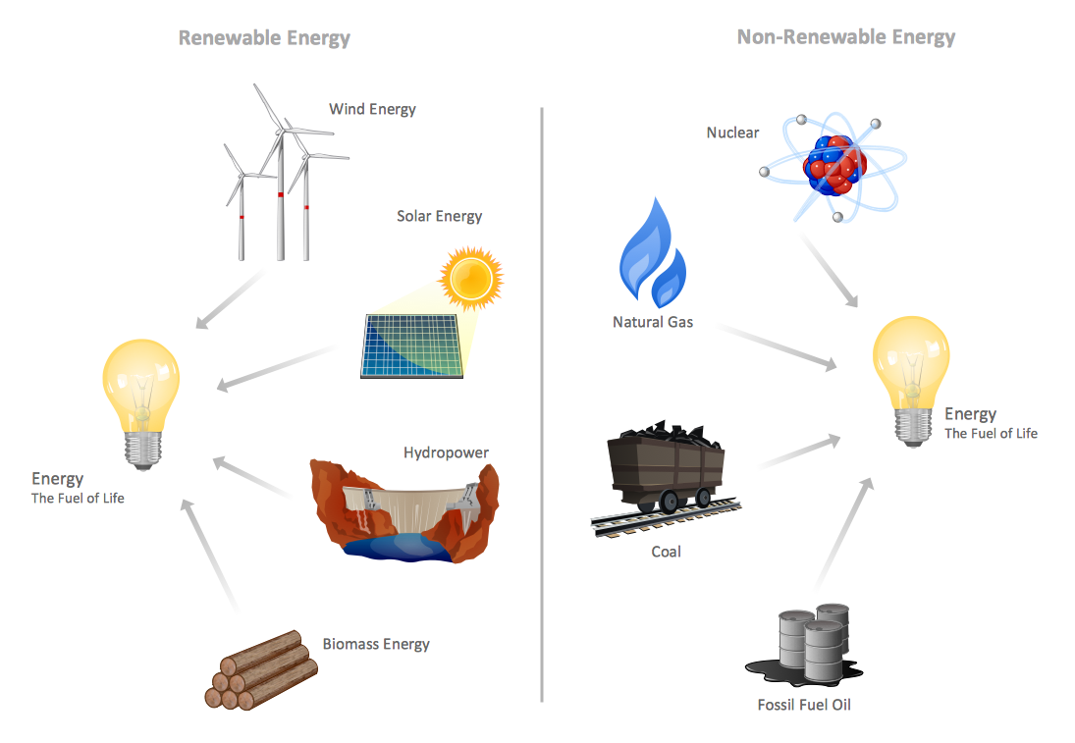
A Quick Introduction to our Topic
Energy is the power or capacity to do work.
Electric Energy is caused by the movement of electric charges called electrons.
Electric Energy is used to power all the devices around us.
These energy resources fall into two main categories, often called renewable and non-renewable energy resources.

Slide 3

Dataset
https://data.oecd.org/energy/crude-oil-import-prices.htm
ucdp-prio-acd-211-csv.zip
https://ucdp.uu.se/
https://ourworldindata.org/renewable-energy
https://ourworldindata.org/fossil-fuels
City and Town Population Totals: 2010-2019 (census.gov)
Form EIA-860 detailed data with previous form data (EIA-860A/860B)

Slide 4

Hypothesis - 1
We anticipate that all countries or regions will reduce their non-renewable energy use. We'd also like to look at the use of non-renewable vs. renewable energy.

Slide 5
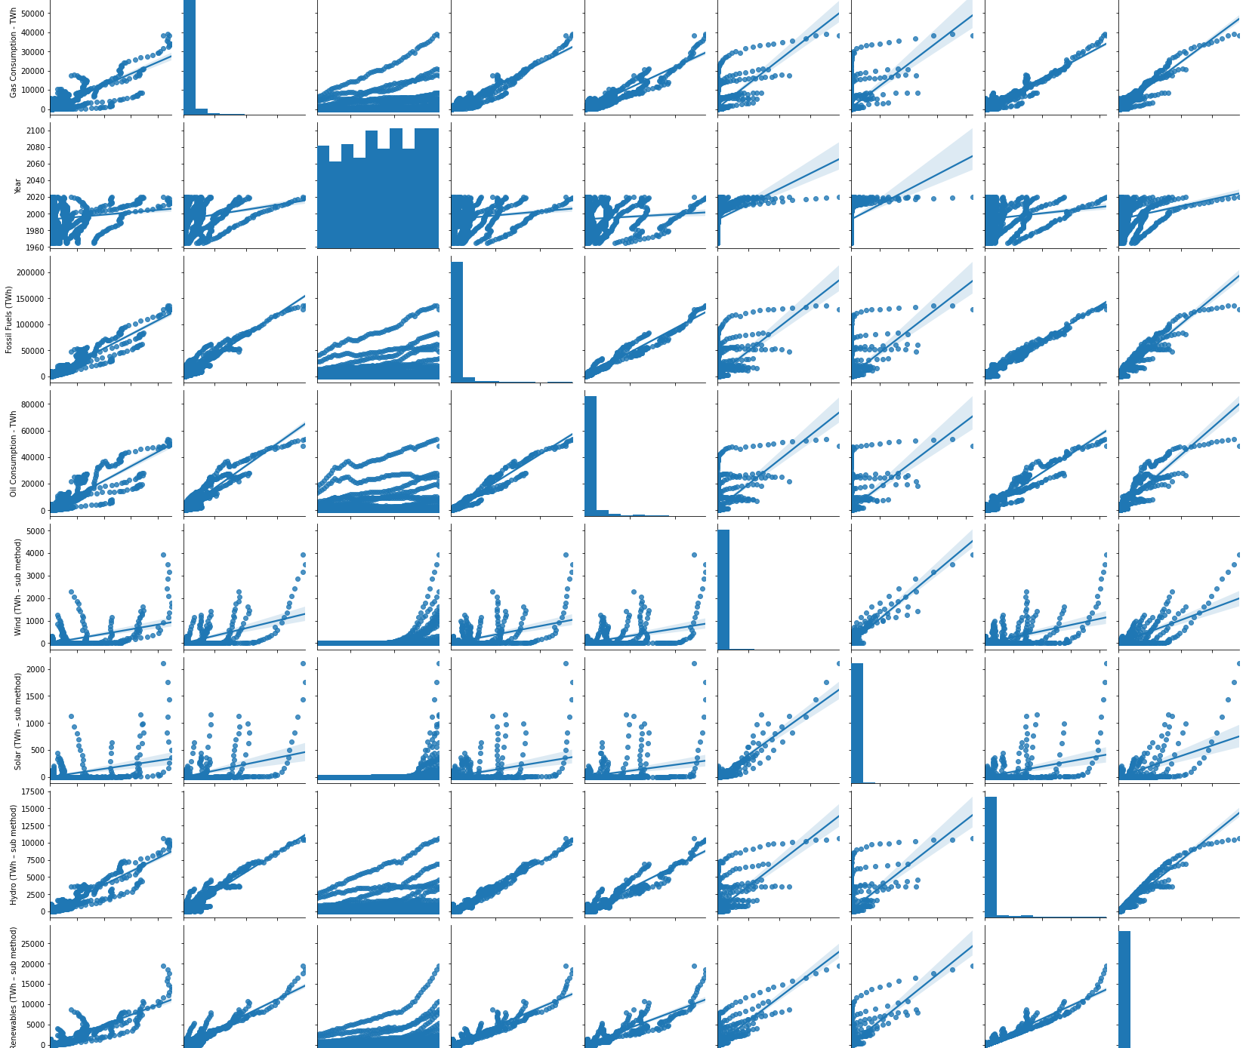
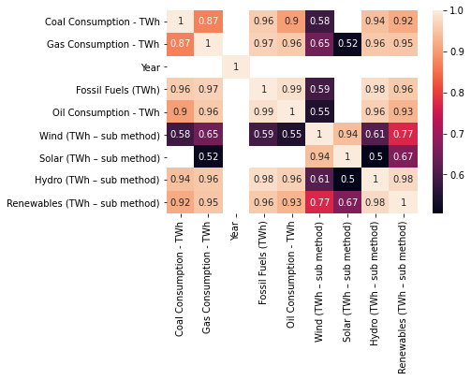
Do the attributes have any relation?
All attributes are positively correlated with each other.
But the amount of posterior data needs to be considered.

Slide 6
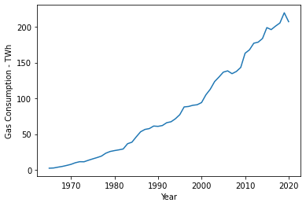
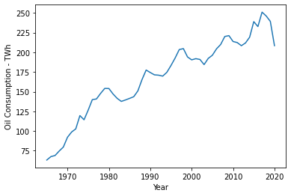
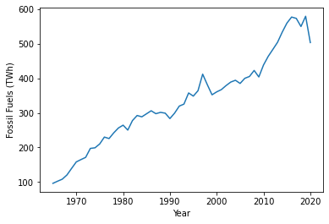
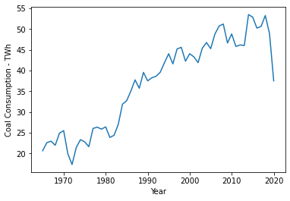
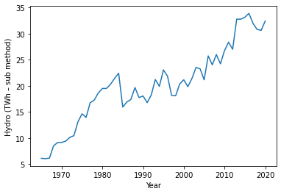
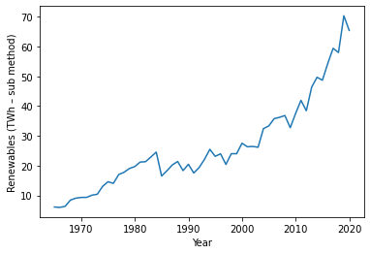
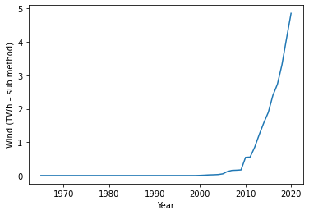
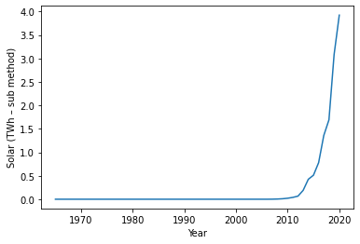

Slide 7
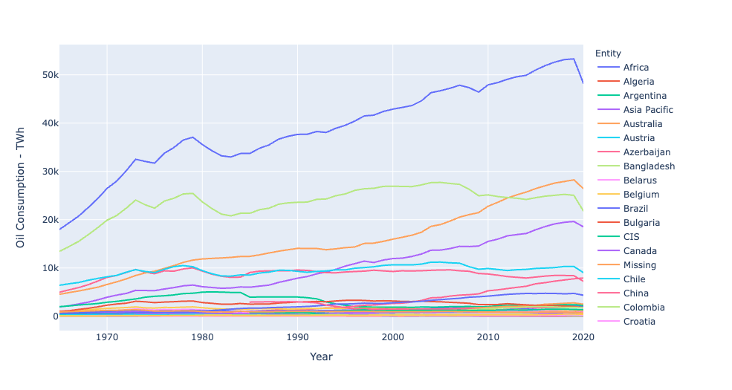
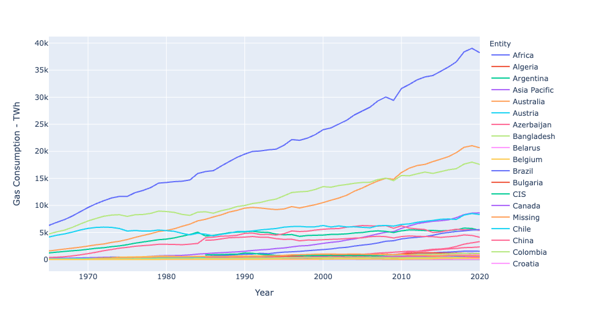
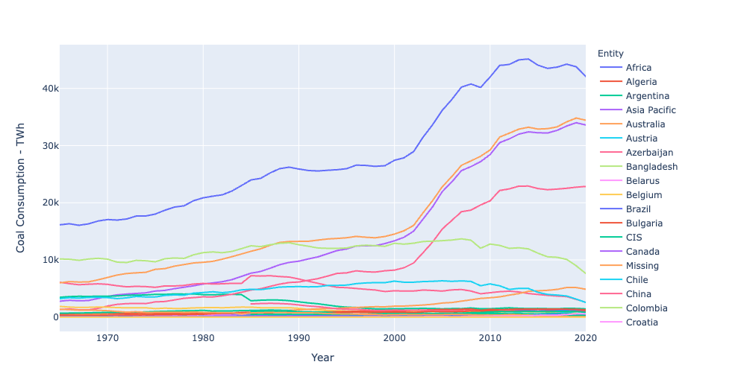
Non-Renewable Energy Consumption

Slide 8
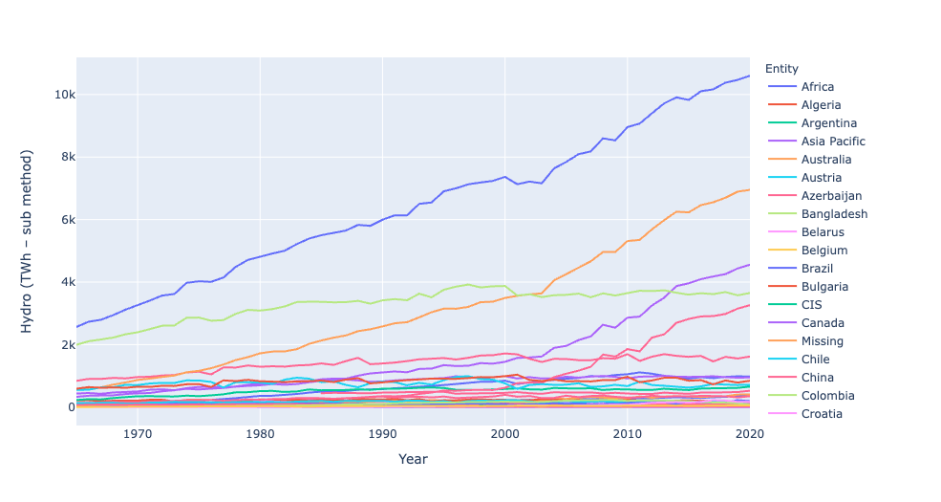
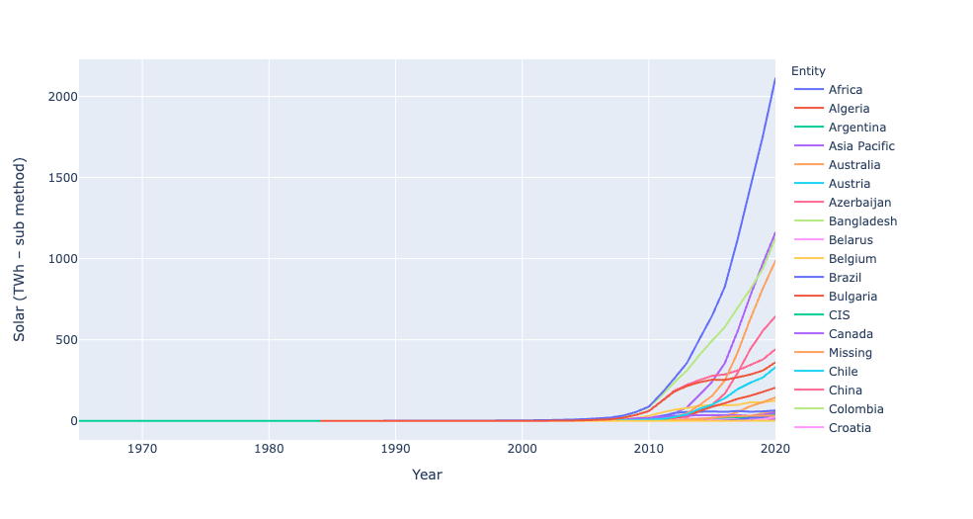
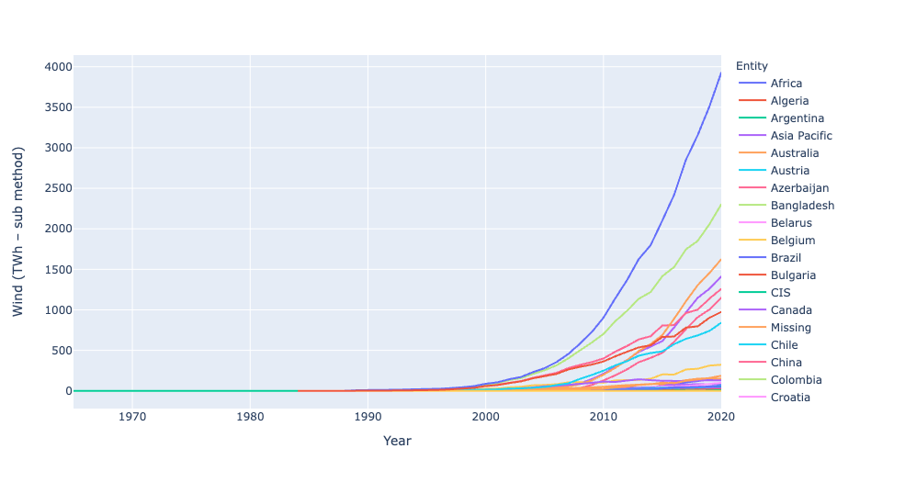
Renewable Energy Consumption

Slide 9
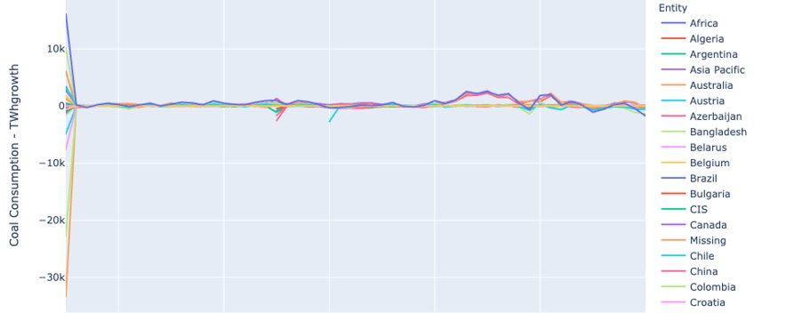
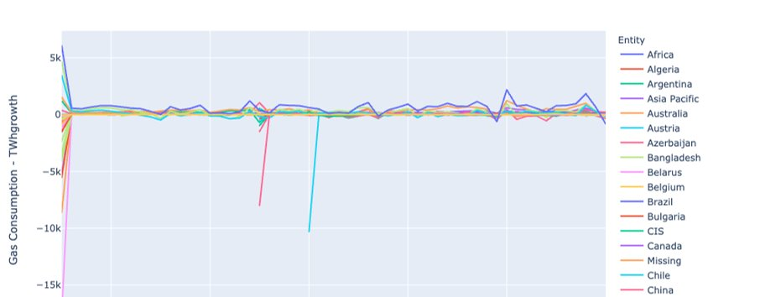
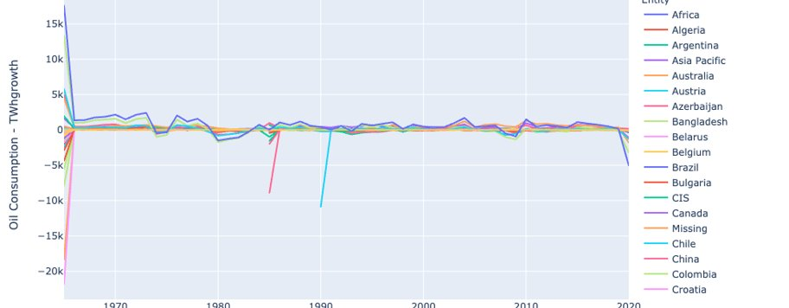
Non-Renewable Energy Growth

Slide 10
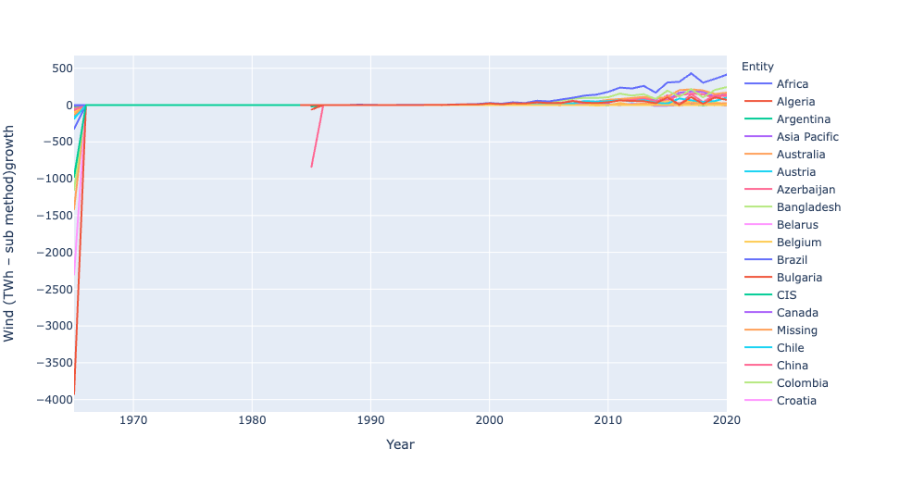
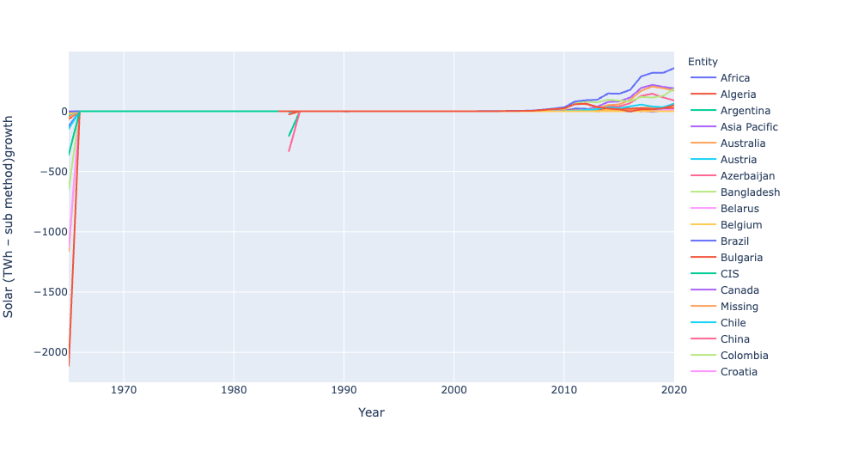
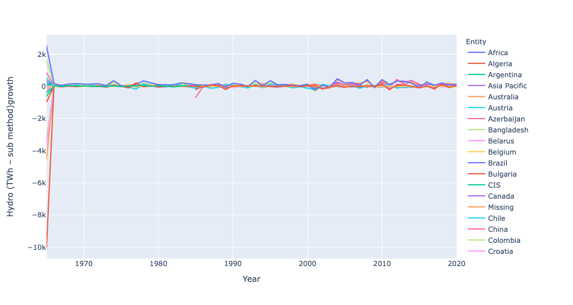
Renewable Energy Growth

Slide 11
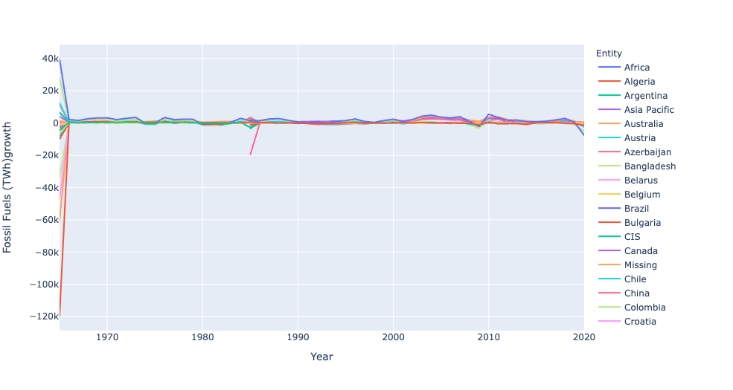
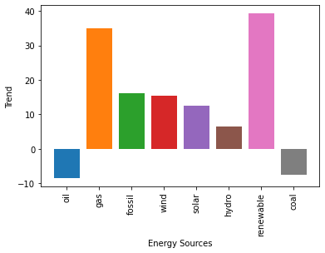
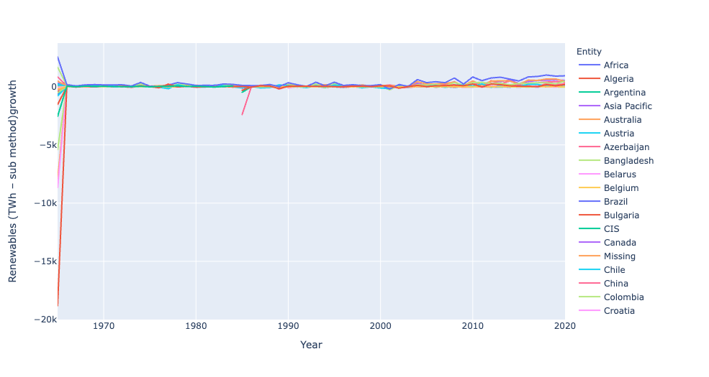
Trends
Out of all, Oil and Coal have negative trends based on recent data.
Surprisingly, Gas has a positive trend which makes fossil fuels collectively have a positive trend.
All the renewable resources have a positive trend which was anticipated.

Slide 12

Why the US isn't ready for clean Energy

Slide 13
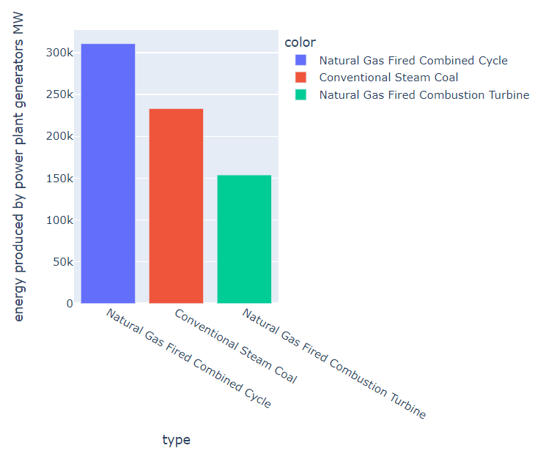
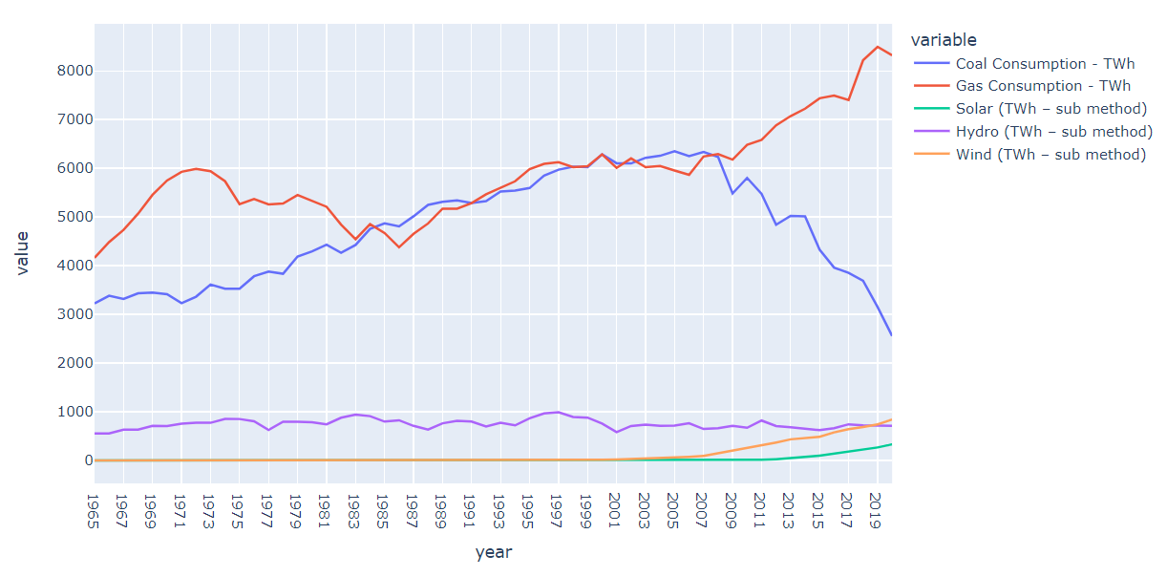
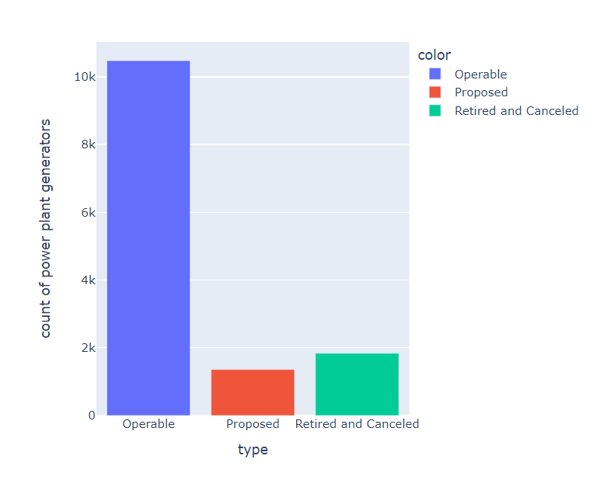
United States Energy Analysis
Data viz using US Energy Information Administration 2020 data

Slide 14
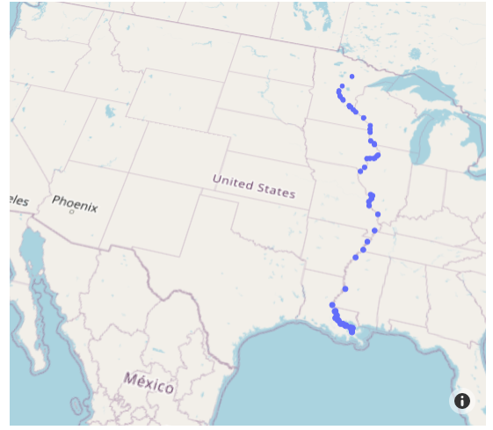
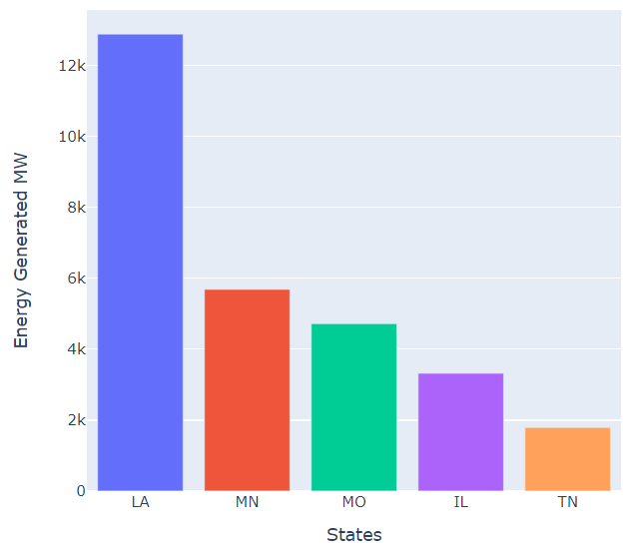
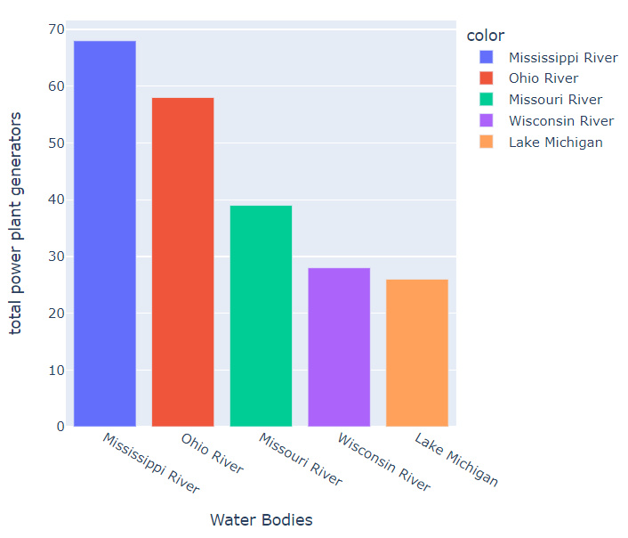
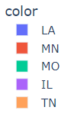
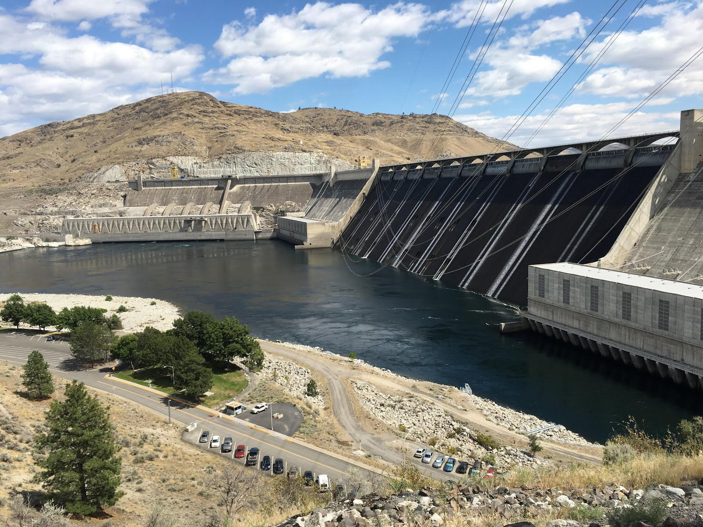
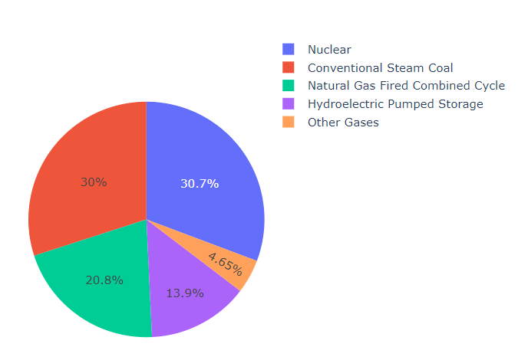
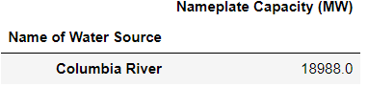
Importance of Water Bodies
Spatial Data plot using scatter_mapbox function in Plotly
Grand Coulee Dame
Source image: City Girl Goes West: Grand Coulee Dam

Slide 15
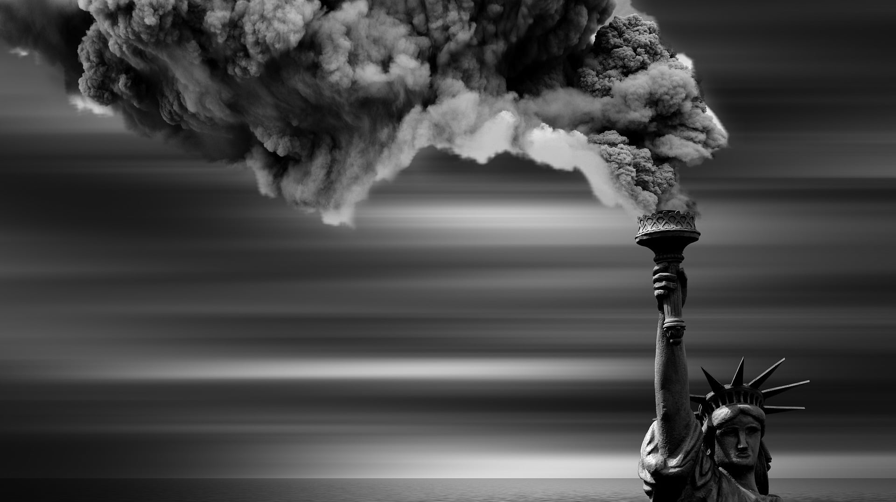

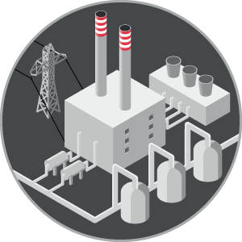

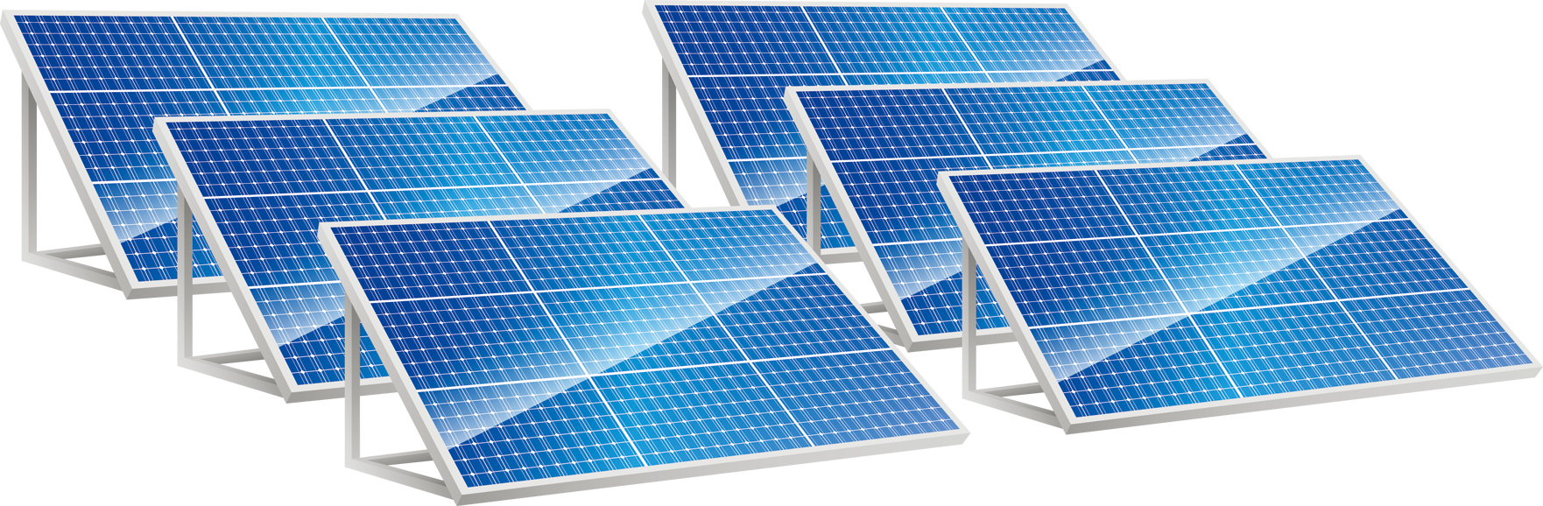
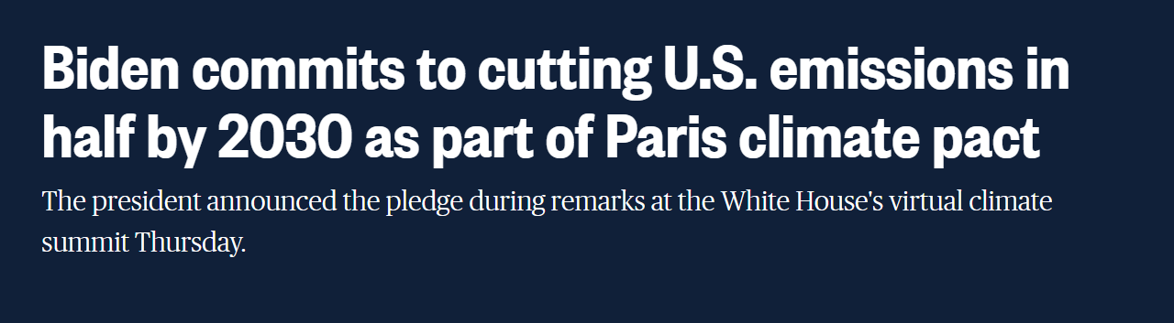

Slide 16


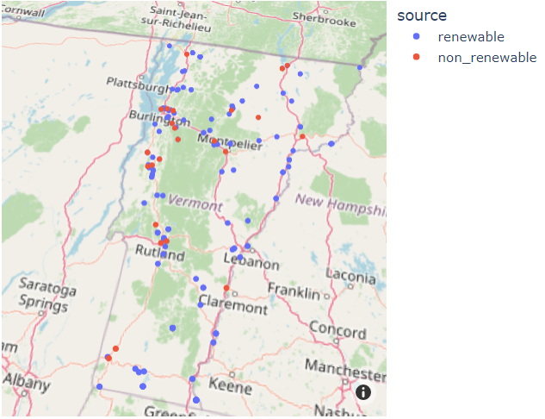
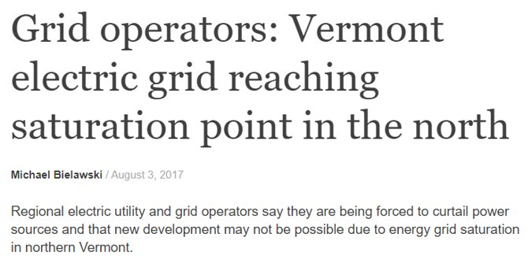
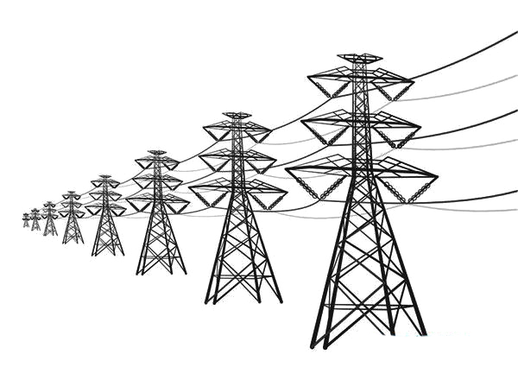

State of Vermont

Slide 17
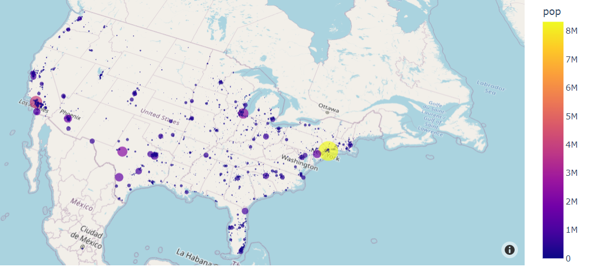
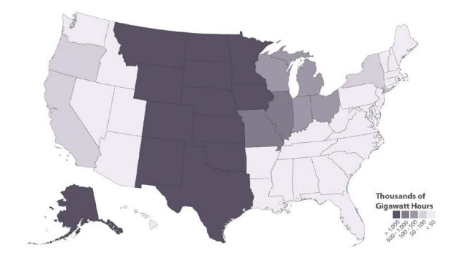
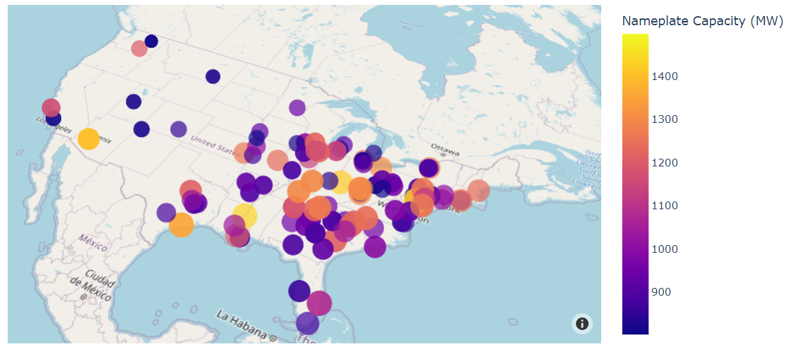
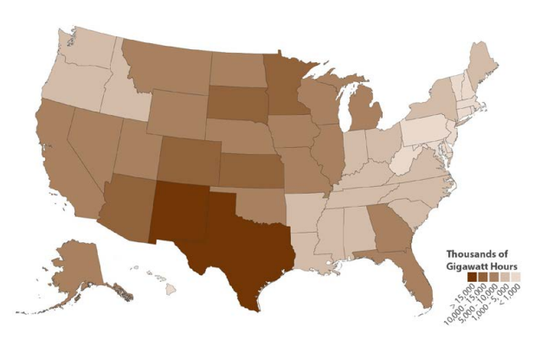
Population vs Major Power Plants in US
Potential Areas for Renewable Energy:
Source (The National Renewable Energy Laboratory (NREL) )

Slide 18

What will be needed to build more clean energy sources in the US?
Land
People
Investment

Slide 19
Hypothesis - 2
As the state conflicts increase, we expect the prices of energy resources to increase.

Slide 20
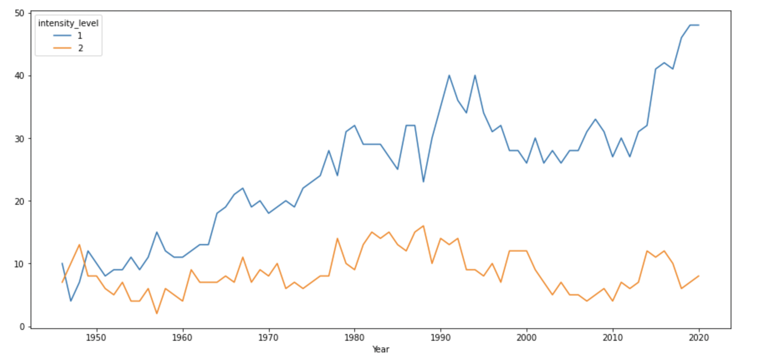
Armed Conflicts dataset over the years
The dataset spans over 1946-2020
The graph shows the intensity level w.r.t cumulative count of the countries in each year

Slide 21
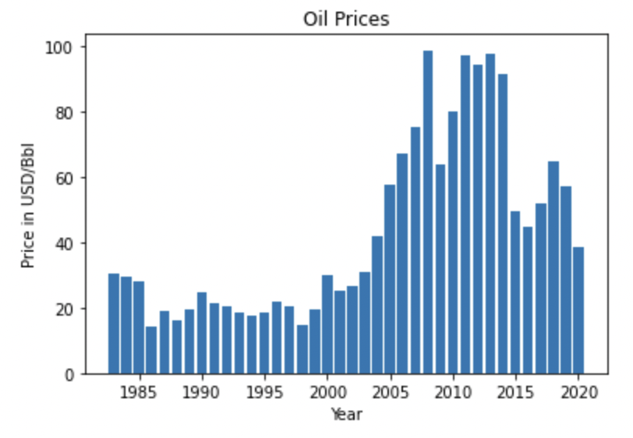
Oil Price dataset
The duration of the dataset is 1983-2021
Crude oil price in USD/Bbl

Slide 22

Oil price vs armed conflicts

Slide 23

Oil Price change v/s Armed Conflicts

Slide 24


Does armed conflicts affect oil price?

Slide 25


Correlation
Finding the correlation between the oil price and conflicts through linear regression models
Specific time-periods
Finding other factors along with the oil price during time period of a specific war/conflict

Slide 26

Hypothesis – Rejected?

Slide 27

Thank You!
Notes:
Hi

Slide 28

References
U.S. Renewable Energy Technical Potentials: A GIS-Based Analysis (nrel.gov)
https://www.iea.org/reports/global-energy-review-2019/natural-gas
Grid operators: Vermont electric grid reaching saturation point in the north | True North Reports
Biden commits to cutting U.S. emissions in half by 2030 as part of Paris climate pact (nbcnews.com)
Green Energy in America Needs a Lot More Land: Map (bloomberg.com)
How Much Investment Is Needed For A Clean Energy Future? (forbes.com)

